Slide 1

IT-1101: IT Fundamentals
for
1st Year 1st Semester of B.Sc (Honors) in IT (10th Batch)
Lecture: 09
Software & Programming Language
Prepared by:
K M Akkas Ali
akkas_khan@yahoo.com, akkas@juniv.edu
Assistant Professor
Institute of Information Technology (IIT)
Jahangirnagar University, Dhaka-1342

Slide 2
Lecture-09: Software & Programming Language
Topics to be Discussed
8.1 | Software and its Classification
 | 8.1.1 | Software Vs. Program
 | 8.1.2 | Classification of Software
8.2 | Programming Language and its Classification
 | 8.2.1 | Definition and Function of Programming Language
 | 8.2.2 | Kinds of Programming Language
 | 8.2.3 | High-level Vs. Low-level Programming Language
 | 8.2.4 | Source Code Vs. Object Code
8.3 | Translator Programs
8.4 | Algorithm and its Complexity
8.5 | Flowchart and the Symbols used in a Flowchart
8.6 | Problem Solving Steps

Slide 3
8.1 Software & its Classification
8.1.1 | Software Vs. Program
Definition of Software and Program:
The term software refers to the organized sets of instructions that tell the hardware what to do.
The finite set of instructions that the computer follows to solve a particular problem is called a computer program.
Collectively, the group of programs that a computer needs to function is known as software.
All software utilizes at least one hardware device to operate.
Examples of Software:
Windows, DOS, Unix, Linux, Mac OS, Microsoft Word, Microsoft Excel, Adobe PhotoShop, Mozilla Firefox etc.

Slide 4
8.1 Software & its Classification
8.1.2 | Classification of Software
There are two broad categories of software:
System software
Application software
Definition of System Software:
System software directs the internal operations of the computer, such as managing the input and output devices.
This software does the basic functions necessary to start and operate a computer.
It controls and monitors the various activities of a computer and makes it easier and more efficient to use the computer.
Example of System Software:
Operating systems (e.g., Windows, DOS, Linux, Mac OS etc.)
Utility programs (e.g., Anti-virus, Registry Cleaner, Disk Backup, Disk Defragmenter etc.)

Slide 5
8.1 Software & its Classification
8.1.2 | Classification of Software…
Definition of Application Software:
Application software directs the computer to solve specific user-oriented problems such as preparing payroll, preparing electricity bills, creating your curriculum vitae etc.
Example of Application Software:
Microsoft Word, Microsoft Excel, Adobe PhotoShop, Internet Explorer etc.

Slide 6
8.1 Software & its Classification
8.1.2 | Classification of Software…
Categories of Application Software
Class of Application Soft | Example
Word Processing | Microsoft Word, Word Perfect, Word Star, Latex etc.
Spreadsheet Analysis | Microsoft Excel, Lotus-1-2-3 etc.
Database Software | Microsoft Access, Oracle, FoxPro etc
Presentation Design | Microsoft PowerPoint
Graphics Software | Adobe PhotoShop, MS Paint, Adobe Illustrator etc
Browsing Software | Internet Explorer, Netscape Navigator, Opera etc.
E-Mail Software | Eudora, Outlook Express, Pegasus Mail etc.

Slide 7
8.2 Programming Language & its Classification
8.2.1 | Definition and Function of Programming Language
What is Programming Language:
A programming language is a set of written symbols and characters governed by a set of rules that instruct the computer to perform specified tasks.
All computers understand only binary machine language.
Some programming languages are easy to learn, others are better for business applications. Some languages are even English like.
Example of Programming Languages:
C, ForTran, Pascal, Basic, Java, Ada, Prolog etc.

Slide 8
8.2 Programming Language & its Classification
8.2.2 | Kinds of Programming Language
Three types of programming language are available; these are:
Machine language (known as low-level language)
Assembly language (known as symbolic language)
High-level language (known as procedure-oriented language)
Note:
Machine language and Assembly language are known as low-level language

Slide 9
8.2 Programming Language & its Classification
8.2.3 | High-level Vs. Low-level Programming Language
High-level Language:
High-level programming language is easy to learn, use and debug. Programs written by this language is machine independent.
It uses symbols and words which are similar to those of ordinary mathematics and English-like.
It is the most widely used programming language.
Example of Some High-level Languages:
ForTran (Formula Translation)
BASIC ( Beginner’s All-purpose Symbolic Instruction Code)
COBOL (COmmon Business Oriented Language)
ALGOL (ALGOrithmic Language)
PASCAL
C
PROLOG (PROgramming in LOGic)

Slide 10
8.2 Programming Language & its Classification
8.2.3 | High-level Vs. Low-level Programming Language…
Merits of High-level Language:
A program written by high-level language needs to be translated into a machine language before executing by a special translator program called compiler or interpreter.
This language is easier to learn, code, and understand.
Maintenance and documentation of the programs written by high-level language is easy.
Programs written by this language is easy to debug.
Demerits of High-level Language:
Since, program written by a high-level language needs compilation, hence more time is required for execution of the program than to machine language program.
Each time the source program is modified, it has to be recompiled.
Less efficient than machine language.

Slide 11
8.2 Programming Language & its Classification
8.2.3 | High-level Vs. Low-level Programming Language…
Low-level Language:
Low-level programming language is not easy to learn, use and debug.
Example of Low-level Languages:
Binary language
Assembly language
Machine Language:
Every computer has its own language that need not to be translated. This language is called machine language.
In machine language, binary code is used to write a program.
Programs written by this language is machine dependent.
The computer understands this language directly.

Slide 12
8.2 Programming Language & its Classification
8.2.3 | High-level Vs. Low-level Programming Language…
Assembly Language:
In assembly language, the sequence of programs is represented by symbolic code called mnemonics.
Computer cannot understand assembly language.
Before executing, an assembly language program must be translated into machine language by a special translator program called assembler.
This language is machine dependent.

Slide 13
8.2 Programming Language & its Classification
8.2.3 | High-level Vs. Low-level Programming Language…
Merits of Machine Language:
No translation or compilation of a machine language program is needed.
Programs written in machine language are directly understood by the CPU.
Programs written by machine language can be executed very quickly.
Demerits of Machine Language:
Writing programs in machine language is tedious, time-consuming, and highly error-prone.
It requires a high level of programming skill.
Machine language is machine dependent (i.e. a program that has been developed for a particular machine cannot be run on another machine).
It is very difficult to correct or modify a machine language program.

Slide 14
8.2 Programming Language & its Classification
8.2.4 | Source Code Vs. Object Code
Source Code:
A program written in high-level or assembly language is called source code of the program.
Object Code:
Any program not written in machine language has to be translated before it is executed by the computer.
Translation of source code into machine code is called object code.

Slide 15
8.3 Translator Programs
What is Translator Program
Translator is a computer program that performs the task of converting a program written in one language into a program in another language.
Kinds of Translator Program:
There are basically three types of translator programs:
Assembler
Interpreter
Compiler

Slide 16
8.3 Translator Programs
Assembler:
It is a translator program that converts assembly language into machine language.
Compiler:
It is a translator program that translates the entire program at a time written in high-level language into machine language.
Interpreter:
It is a translator program that translates and executes each line at a time of the source code program written in a high-level language into machine language.

Slide 17
8.3 Translator Programs
Comparison between Translator and Interpreter
The compiler translates the entire program at a time while the interpreter translates the single line at a time.
Use of an interpreter can save more space since the program itself is quite small in size.
Compiler takes more space because of its long program.
It is required less execution time in compiler than that of interpreter.
It is required less main memory in case of an interpreter than that of a compiler.

Slide 18
8.4 Algorithm and its Complexity
What is Algorithm?
A well-defined finite sequence of steps or instructions for solving a particular problem is called algorithm.
There are several algorithms or strategies for solving a given problem.
An algorithm should be sufficiently well structured and detailed, so that it can be easily translated into some programming language such as C, ForTran, Pascal, Basic etc.
The time and the space an algorithm uses are two major measures of the efficiency of an algorithm.

Slide 19
8.4 Algorithm and its Complexity
Complexity of an Algorithm:
The complexity of an algorithm is a function describing the efficiency of the algorithm in terms of the amount of data the algorithm must process.
An algorithm has two main complexity:
Time complexity
It is a function that describes the amount of time an algorithm takes in terms of the amount of input to the algorithm.
Space complexity
It is a function that describes the amount of memory (space) an algorithm takes in terms of the amount of input to the algorithm.

Slide 20
8.5 Flowchart and the Symbols Used in Flowchart
What is Flowchart?
Pictorial representation of an algorithm is called its flowchart.
Flowcharts are composed of symbols of different sizes and shapes.
The shape of the symbols used in flowchart determines the kinds of operations being performed.
The size of the symbols has no effects on its meaning and is determined by how much is to be written inside it.

Slide 21
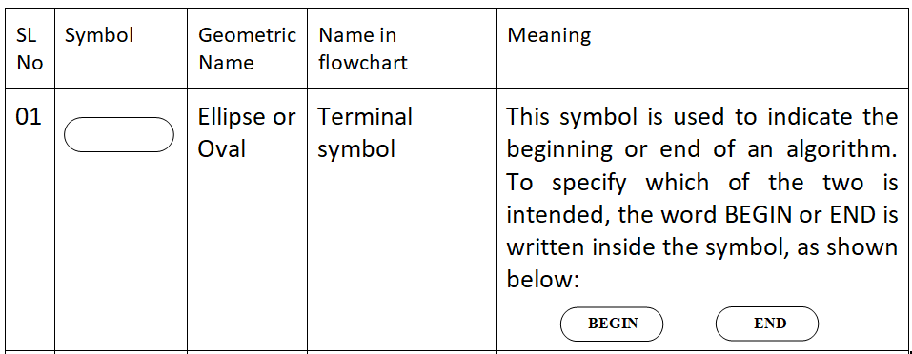
8.5 Flowchart and the Symbols Used in Flowchart
Basic Symbols used in Flowchart
Some ANSI (American National Standard Institute) symbols used in flowchart are given below along with their name and meaning.

Slide 22
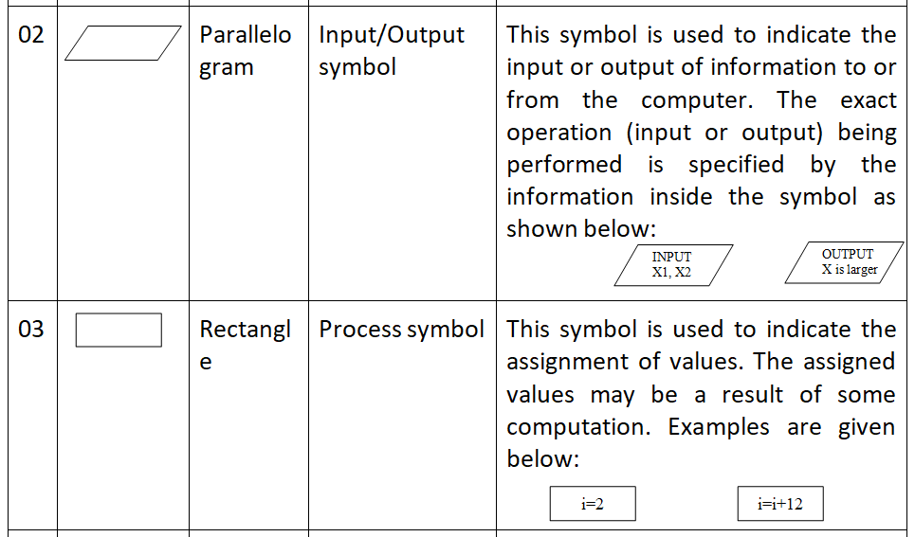
8.5 Flowchart and the Symbols Used in Flowchart
Basic Symbols used in Flowchart…

Slide 23
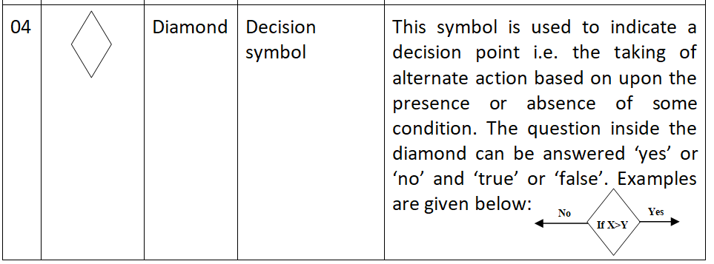
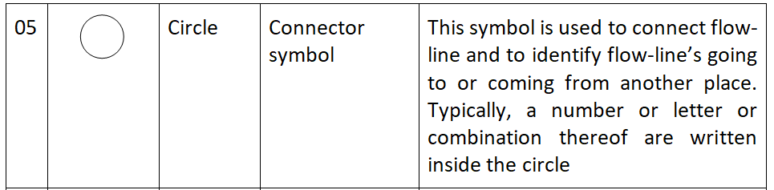
8.5 Flowchart and the Symbols Used in Flowchart
Basic Symbols used in Flowchart …

Slide 24
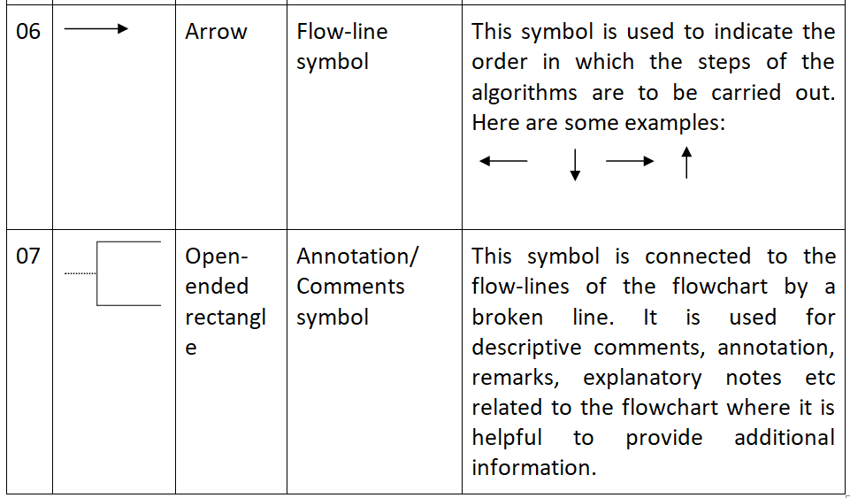
8.5 Flowchart and the Symbols Used in Flowchart
Basic Symbols used in Flowchart …

Slide 25
8.6 Problem Solving Steps
The series of steps for the development of a program is known as program development process.
The steps involved are:
Problem analysis
Algorithm development
Program coding
Program compilation and execution
Program debugging and testing
Program documentation

Slide 26
8.6 Problem Solving Steps
Problem analysis:
It requires that we understand what we are being asked to do and identify the information required to be computed and printed.
Algorithm development:
After analyzing the problem and identifying the input/output data, the problem is formulated into a carefully constructed list of statements called algorithm that describes the sequence of steps to be performed.
Program coding:
After developing the algorithm of the problem, it is then coded using a programming language that will make up the program.

Slide 27
8.6 Problem Solving Steps
Program compilation and execution:
After coding the program, it needs to be translated into machine language for execution.
Program debugging and testing:
The program may not execute (compile or run) due to the program error or bug. Therefore, the program is to be debugged and then tested till it executes successfully.
Program documentation:
This step provides a written description of each step of the program. It also provides operator’s manual so that the user can use the program.

Slide 28
Discussion Points
1. Software and its Classification
2. High-level Vs. Low-level Programming Language
3. Translator Programs
4. Flowchart
5. Problem Solving Steps

Slide 29

Have a question?
Thank you…

